Slide 1

CAR PRICE PREDICTION
Submitted by:
Madhurima Srivastava

Slide 2
ACKNOWLEDGMENT
I have taken efforts in this project. However, it would not have been possible without the kind support and help of many individuals and organizations. I would like to extend my sincere thanks to all of them.
I am highly indebted to Flip Robo Technologies Bangalore for their guidance and constant supervision as well as for providing necessary information regarding the project & also for their support in completing the project.
I want to thank my SME Mohd. Kashif for providing the project and helping us to solve the problem and addressing out our Query in right time.
I would like to express my special gratitude and thanks to industry persons for giving me such attention and time.

Slide 3
INTRODUCTION
BUSINESS PROBLEM FRAMING With the covid 19 impact in the market, we have seen lot of changes in the car market. Now some cars are in demand hence making them costly and some are not in demand hence cheaper. One of our clients works with small traders, who sell used cars. With the change in market due to covid 19 impact, our client is facing problems with their previous car price valuation machine learning models. So, they are looking for new machine learning models from new data. We have to make car price valuation model.
REVIEW OF LITERATURE This project is more about exploration, feature engineering and classification that can be done on this data. Since we scrape huge amount of data that includes more car related features, we can do better data exploration and derive some interesting features using the available columns. The goal of this project is to build an application which can predict the car prices with the help of other features. In the long term, this would allow people to better explain and reviewing their purchase with each other in this increasingly digital world.

Slide 4
Data Collection phase
Model building phase: After collecting the data, you need to build a machine learning model. Before model building do all data pre-processing steps. Try different models with different hyper parameters and select the best model. ⎝Follow the complete life cycle of data science. Include all the steps like:
1. Data Cleaning
2. Exploratory Data Analysis
3. Data Pre-processing
4. Model Building
5. Model Evaluation
6. Selecting the best model DATA SOURCES AND THEIR FORMATS

Slide 5
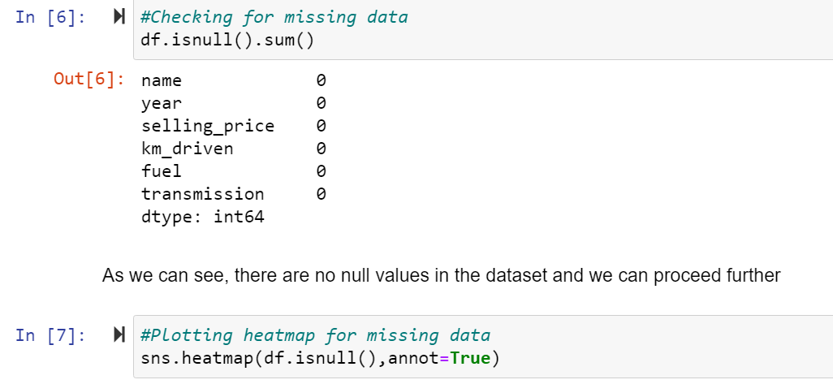
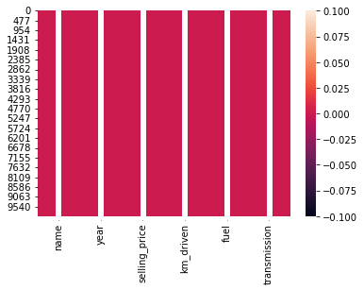
DATA PRE-PROCESSING
Checking for null-values

Slide 6
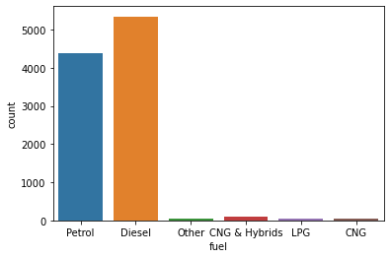
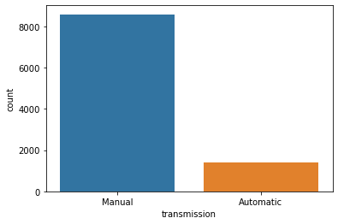
Exploratory Data Analysis
We can see that Diesel and Petrol are the maximum fuels used by cars, whereas CNG and LPG are the least used.
Most of the cars have manual transmission as the highest weightage

Slide 7
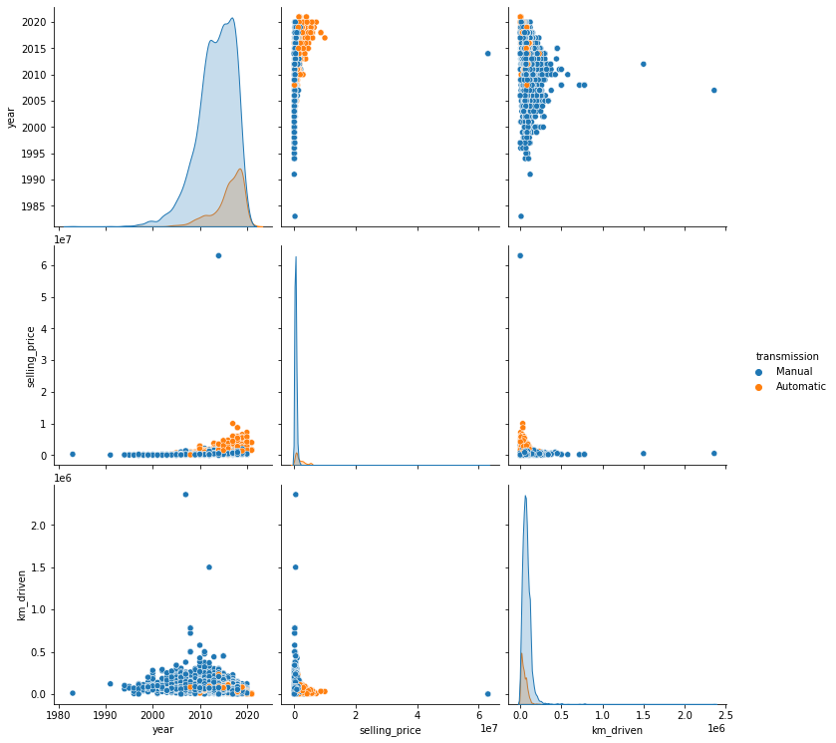
Plotting pairplot for transmission
We can see that manual cars have higher price range than automatic type cars though the distribution were skewed to the right. We can also see the increase of cars between 2010 and 2020.

Slide 8
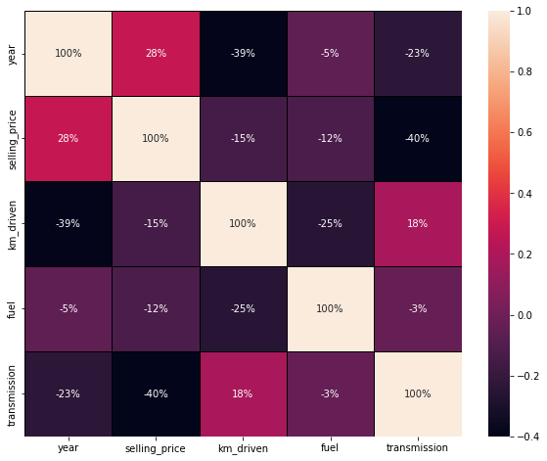
Multivariate Analysis
1.There are more negative correlations present in the dataset
2.Highest positive correlated column has a value of 28%.
3.Highest negatively correlated column has a value of -40%
4.Positively correlated columns have a high impact with the target variable whereas negatively correlated columns have less or zero impact with the target variable.

Slide 9
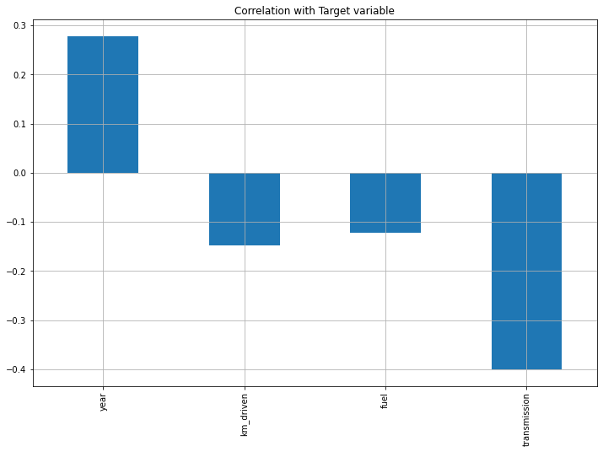
Correlation with target variable
We can see that year column is the only highly correlated column

Slide 10
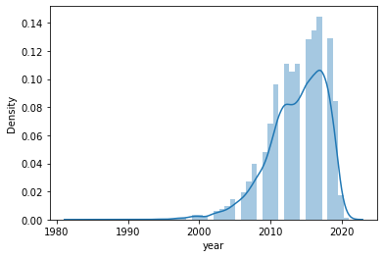
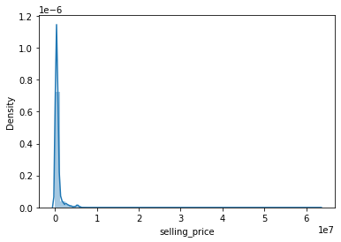
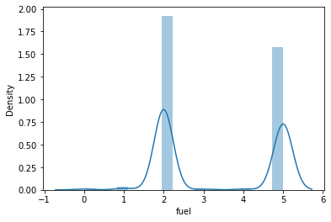
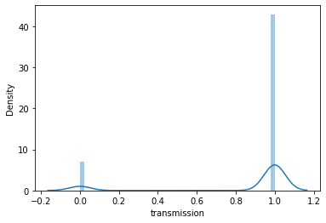
Checking skewness
Large skewness is present in selling_price and km_driven columns and it is due to the presence of outliers

Slide 11
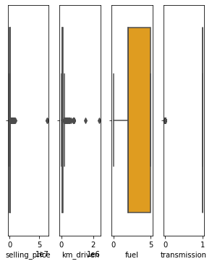
Checking outliers
We can see there are outliers and it can be handled by using z-score method

Slide 12
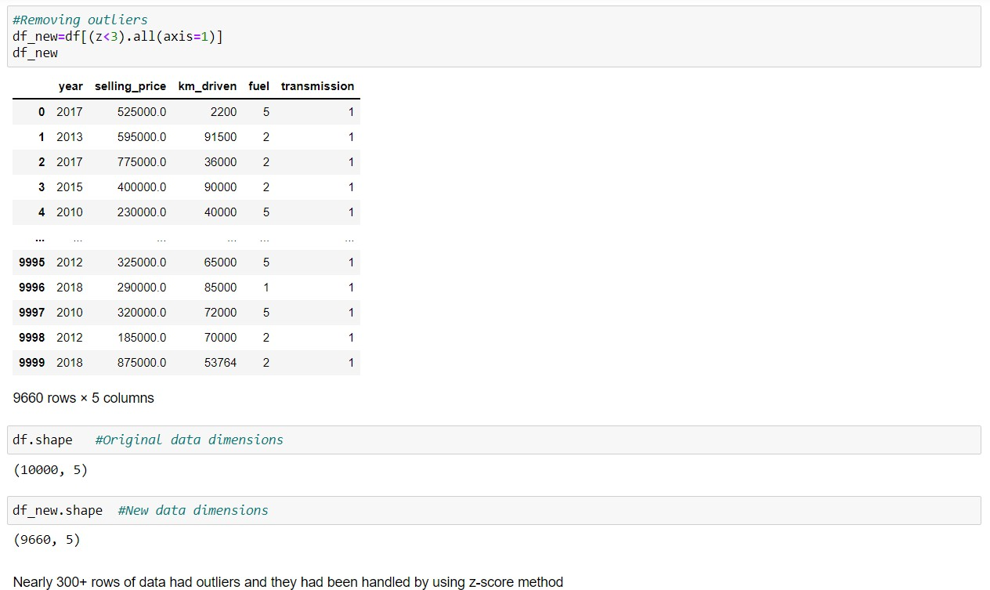
Handling outliers using z-score method
HARDWARE AND SOFTWARE REQUIREMENTS AND TOOLS USED
For doing this project, the hardware used is a laptop with high end specification and a stable internet connection. While coming to software part, I had used anaconda navigator and in that I have used Jupyter notebook to do my python programming and analysis.

Slide 13
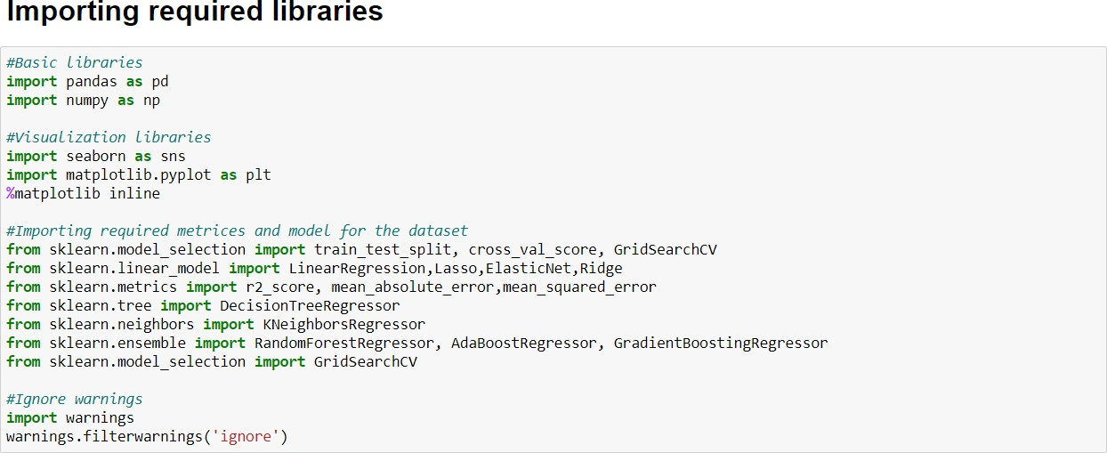
Libraries Used:

Slide 14
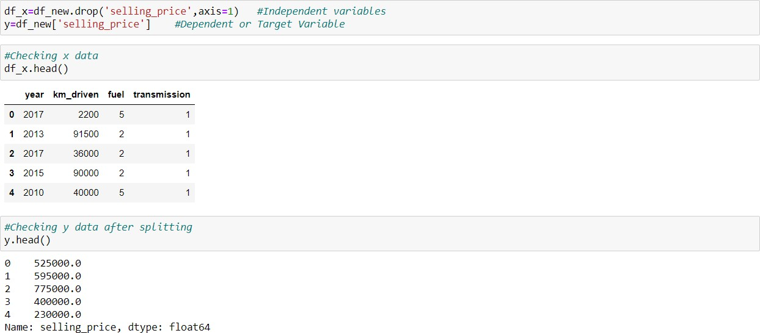
MODEL/S DEVELOPMENT AND EVALUATION

Slide 15
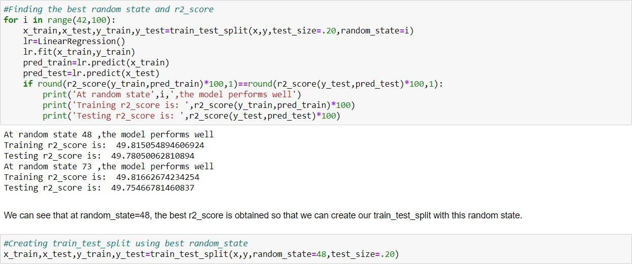
Model Building Finding best random state and r2_score

Slide 16
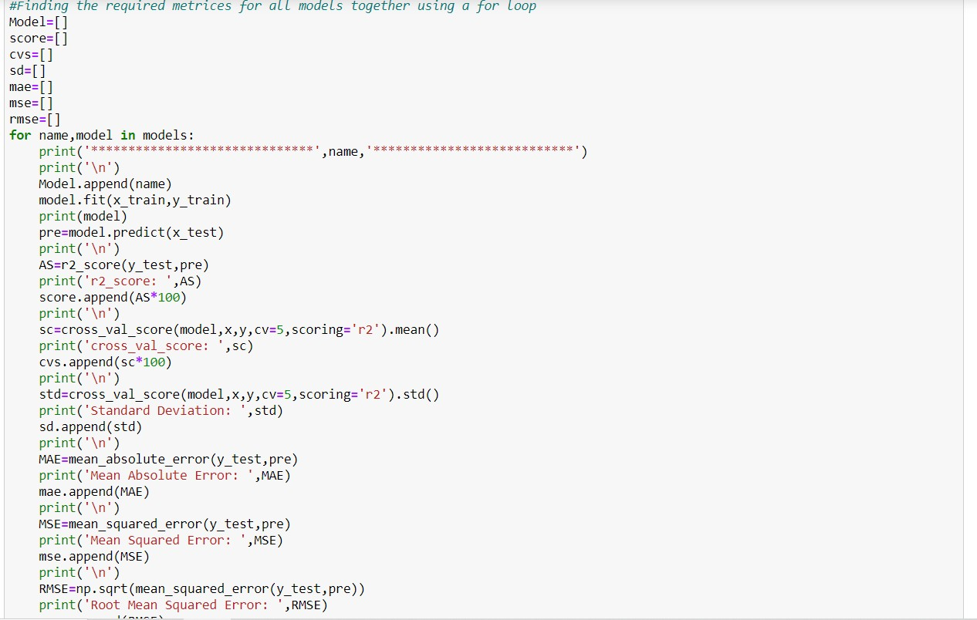
After initializing the instances of the model, we will run a for loop with the required metrics and other regression related scores and we will append the obtained values to empty lists. The code will be as follows:

Slide 17
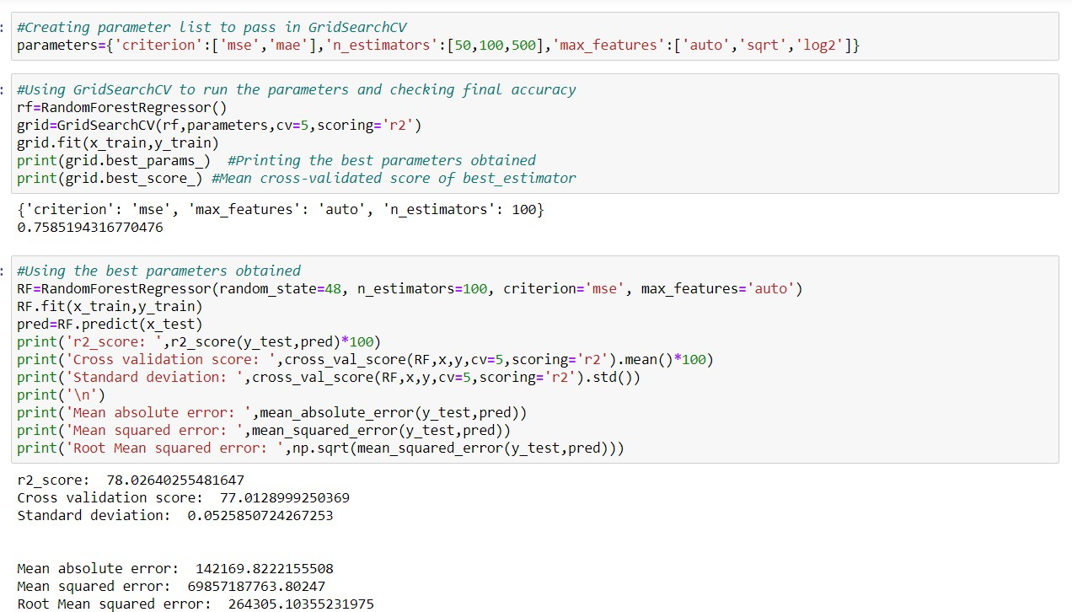
Hyperparameter Tuning Random Forest Regressor
Hyperparameter Tuning
Random Forest Regressor

Slide 18
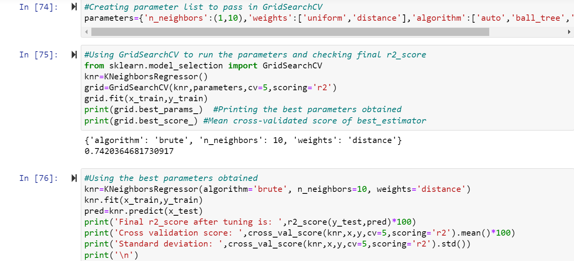
KNeighbors Regressor
After applying Hyperparameter Tuning, we can see that RandomForestRegressor is the best performing algorithm among all other algorithms as it is giving a r2_score of 78.02 and cross validation score of 77.01. It has also the less amount of error values obtained. Lesser the RMSE score, the better the model. Now we will finalize the model. The scores are improved; r2_score from 77.57 to 78.02 and cross_val_score from 77.11 to 77.01, which is good

Slide 19
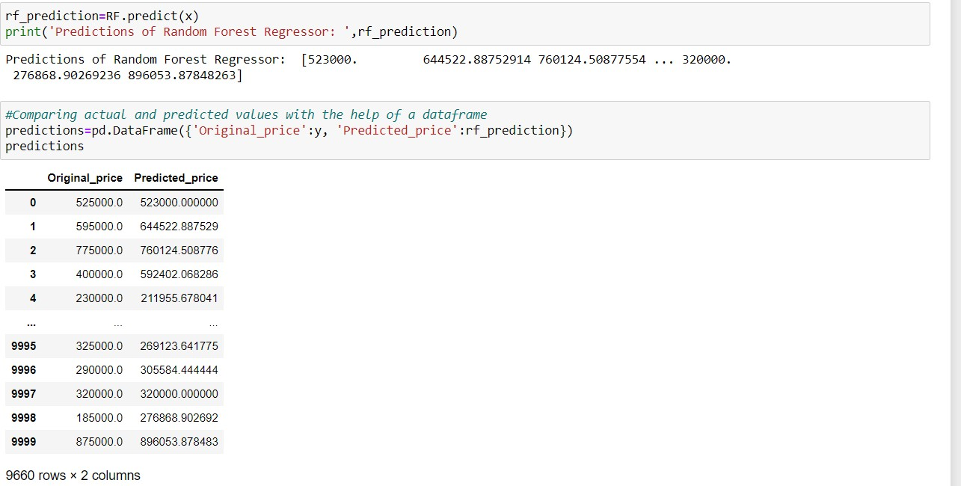
FINAL THE MODEL
Comparing original and predicted price

Slide 20
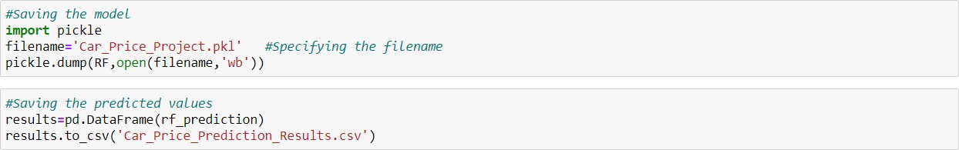
Saving the model

